Slide 1
Digital Portfolio
STUDENT NAME: Kanish Kumar.S
REGISTER NO AND NMID: 212405633 AND asunm1719212405633
DEPARTMENT: BCA
COLLEGE: PERI COLLEGE OF ARTS AND SCIENCE
UNIVERSITY : MADRAS UNIVERSITY

Slide 2
PROJECT TITLE
Lack of a centralized platform to showcase personal and academic projects.
Difficulty for recruiters and peers to evaluate skills without a structured portfolio.
Need for a modern, user-friendly portfolio to represent skills and achievements.

Slide 3


AGENDA
Problem Statement
Project Overview
End Users
Tools and Technologies
Portfolio design and Layout
Features and Functionality
Results and Screenshots
Conclusion
Github Link
3/21/2024 Annual Review

Slide 4

PROBLEM STATEMENT
Absence of a centralized platform → Students often lack a structured digital space to showcase academic and personal projects.
Recruiter difficulty in evaluation → Without a formal portfolio, it is challenging for hiring managers and faculty to objectively assess skills and achievements.
Need for a modern, accessible portfolio → A responsive and user-friendly digital portfolio is essential to represent skills, experiences, and accomplishments effectively.

Slide 5

PROJECT OVERVIEW
Development of a responsive portfolio website → Designed to adapt seamlessly across devices for better accessibility.
Comprehensive showcase → Highlights educational background, technical expertise, and project work in an organized manner.
Professional design focus → Ensures intuitive navigation, clear layout, and a modern visual appeal that aligns with academic and industry expectations.

Slide 6

WHO ARE THE END USERS?
Recruiters and Hiring Managers → Gain a structured overview of skills, projects, and competencies to support informed hiring decisions.
College Faculty and Evaluators → Assess academic performance, technical knowledge, and project outcomes in a centralized format.
Peers, Collaborators, and Potential Clients → Explore project work for inspiration, networking, and opportunities for collaboration.

Slide 7
TOOLS AND TECHNIQUES
Frontend Development → HTML, CSS, and JavaScript used to structure, style, and add interactivity to the portfolio website.
Frameworks → Bootstrap or Tailwind CSS applied for faster, responsive, and mobile-first UI design.
Version Control → Git & GitHub enable collaboration, project tracking, and effective code management.
Hosting Platforms → GitHub Pages or Netlify provide free, reliable, and easily accessible deployment options.

Slide 8
POTFOLIO DESIGN AND LAYOUT
Clean and Modern Aesthetic → Focus on simplicity, readability, and professional appearance to appeal to both academic and professional audiences.
Mobile Responsiveness → Layout adapts seamlessly across devices, ensuring accessibility for recruiters and peers on smartphones, tablets, and desktops.
Well-Defined Sections → Includes About Me, Skills, Projects, and Contact for organized and intuitive navigation.
Consistent Visual Identity → Maintains a uniform color scheme, typography, and spacing for coherence throughout the portfolio.
‹#›

Slide 9
FEATURES AND FUNCTIONALITY
Interactive Navigation Menu → Provides smooth and user-friendly access to different portfolio sections.
Project Showcase → Displays projects with images, descriptions, and links to demonstrate technical expertise and creativity.
Contact Integration → Includes a functional form with email or LinkedIn connectivity to encourage professional networking.
Responsive Design → Ensures optimal performance and visual consistency across all devices and screen sizes.

Slide 10
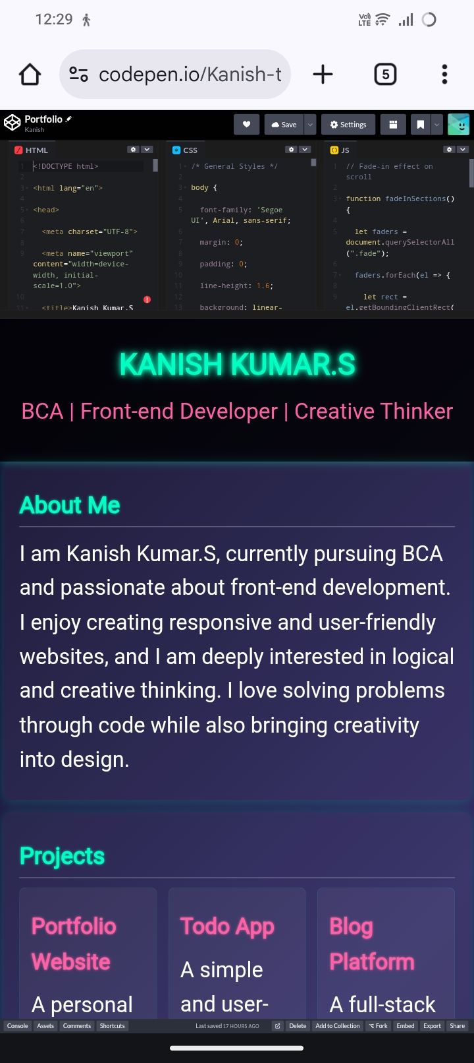
RESULTS AND SCREENSHOTS
3/21/2024 Annual Review
‹#›

Slide 11
CONCLUSION
Structured Digital Identity → The portfolio consolidates academic, technical, and personal achievements into a single accessible platform.
Enhanced Professional Opportunities → Facilitates better visibility to recruiters, faculty, and peers, thereby improving career prospects.
Foundation for Future Growth → Serves as a scalable framework that can be expanded with new projects, skills, and professional experiences.
‹#›

